Slide 1
10-Transport and Communication
Social 4A

Slide 2
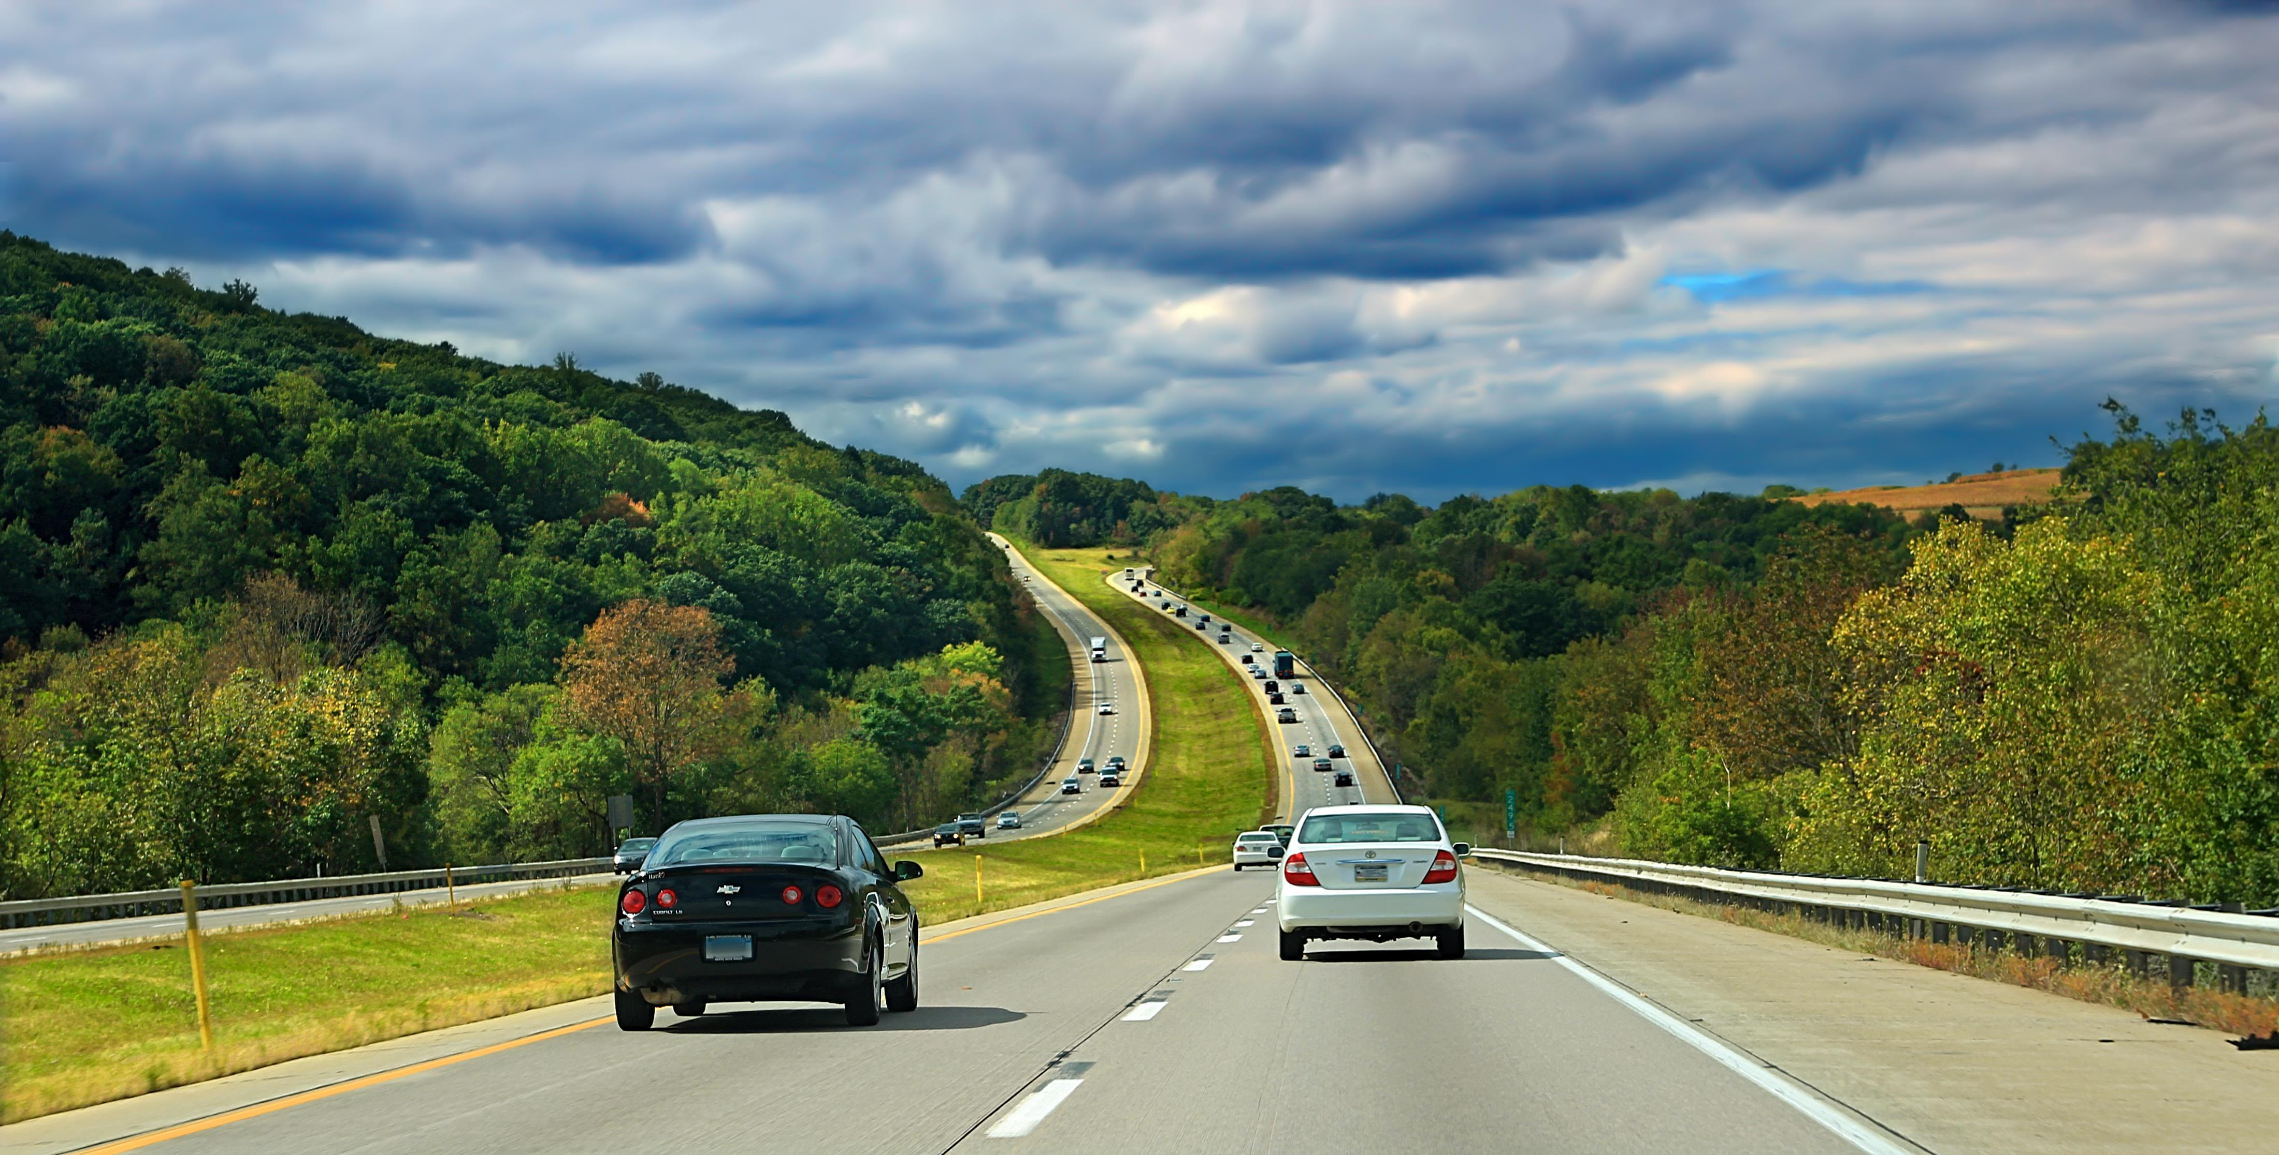
Roadways Our country has a large network of roads . The roads are either metalled or unmetalled . Most roads in cities and towns are metalled . They are made of stone , cement and tar . Unmetalled roads are generally found in villages . The most important roads in India are the national highways and the state highways . The national highways connect state capitals , and other big cities and towns . The state highways connect cities and towns within a state with national highways .

Slide 3
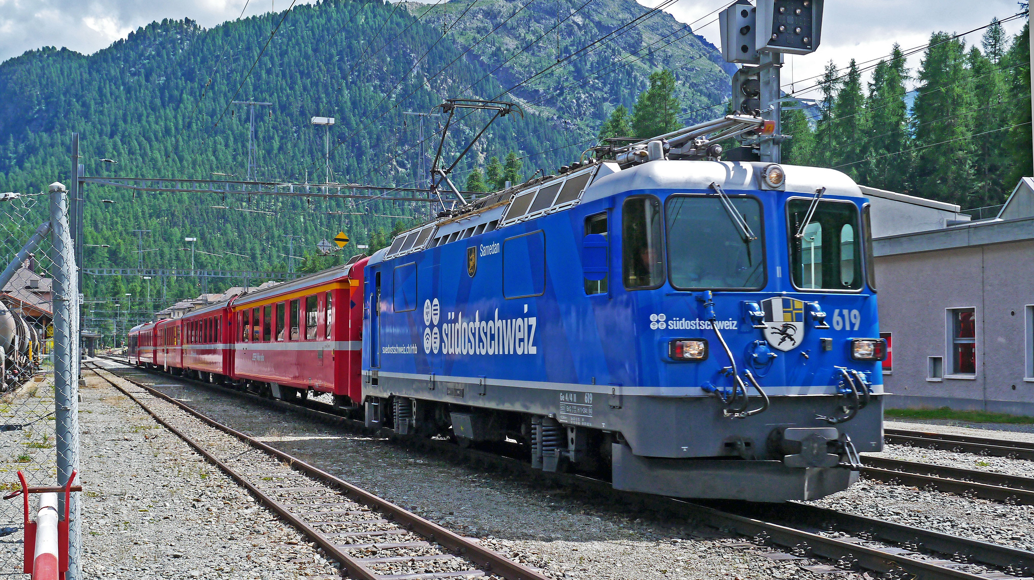
Railways Rail ways are the lifeline of our country . They connect all parts of India . At the of Independence , trains were replaced by diesel and electric engines . This increased the speed of trains . Nowadays trains such as Rajdhani Express travel and Shatabdi Express travel at a speed of 120 – 130 kilometres per hour . In some cities , there are Metro trains . Move on elevated or under ground tracks . Mumbai has a well – connected network of local trains . One of the most important , commonly used and very cost effective modes of commuting and goods carriage over long , as will as , short distances .

Slide 4
Waterways Water transport is the cheapest mode of transport and most suitable for transporting heavy goods . Passenger ships carry people . Cargo ships transport goods . Tanker ships carry petroleum and oil . Along India ‘s coastline there are 13 major and nearly 200 minor ports . The Deendayal Port ( Gujarat ) and the Paradip port ( Odisha ) handle a large quantity of cargo .

Slide 5
Communication Sending and receiving messages is called communication . Long ago , messages took many days or weeks to reach . Today they reach in seconds . Communication is the act of transferring or exchanging information from one place , person or group of people to another .

Slide 6
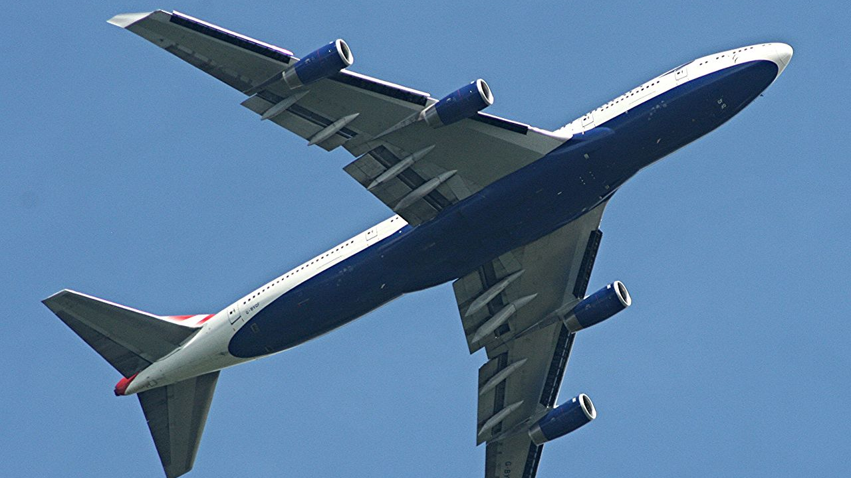
Airways Aero planes are the fastest mode of transport . Major cities and towns of India are connected by airways . Aero plains transport people and goods , especially perishable goods such as fresh fruits , flowerers and vegetables , to far – off places . Some aero planes also carry mails .
This Photo by Unknown Author is licensed under CC BY-SA

Slide 7
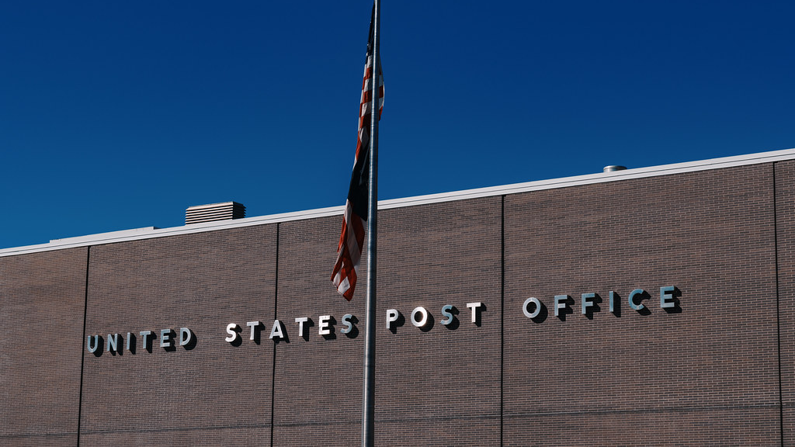
Postal service India ’s postal service is called India’s post . It is the largest postal network in the world . People go to a post office to buy stamps , inland letters , postcards and stamped envelopes . Letters and parcels are either sent through ordinary post or through a faster service called Speed Post .
This Photo by Unknown Author is licensed under CC BY-SA

Slide 8
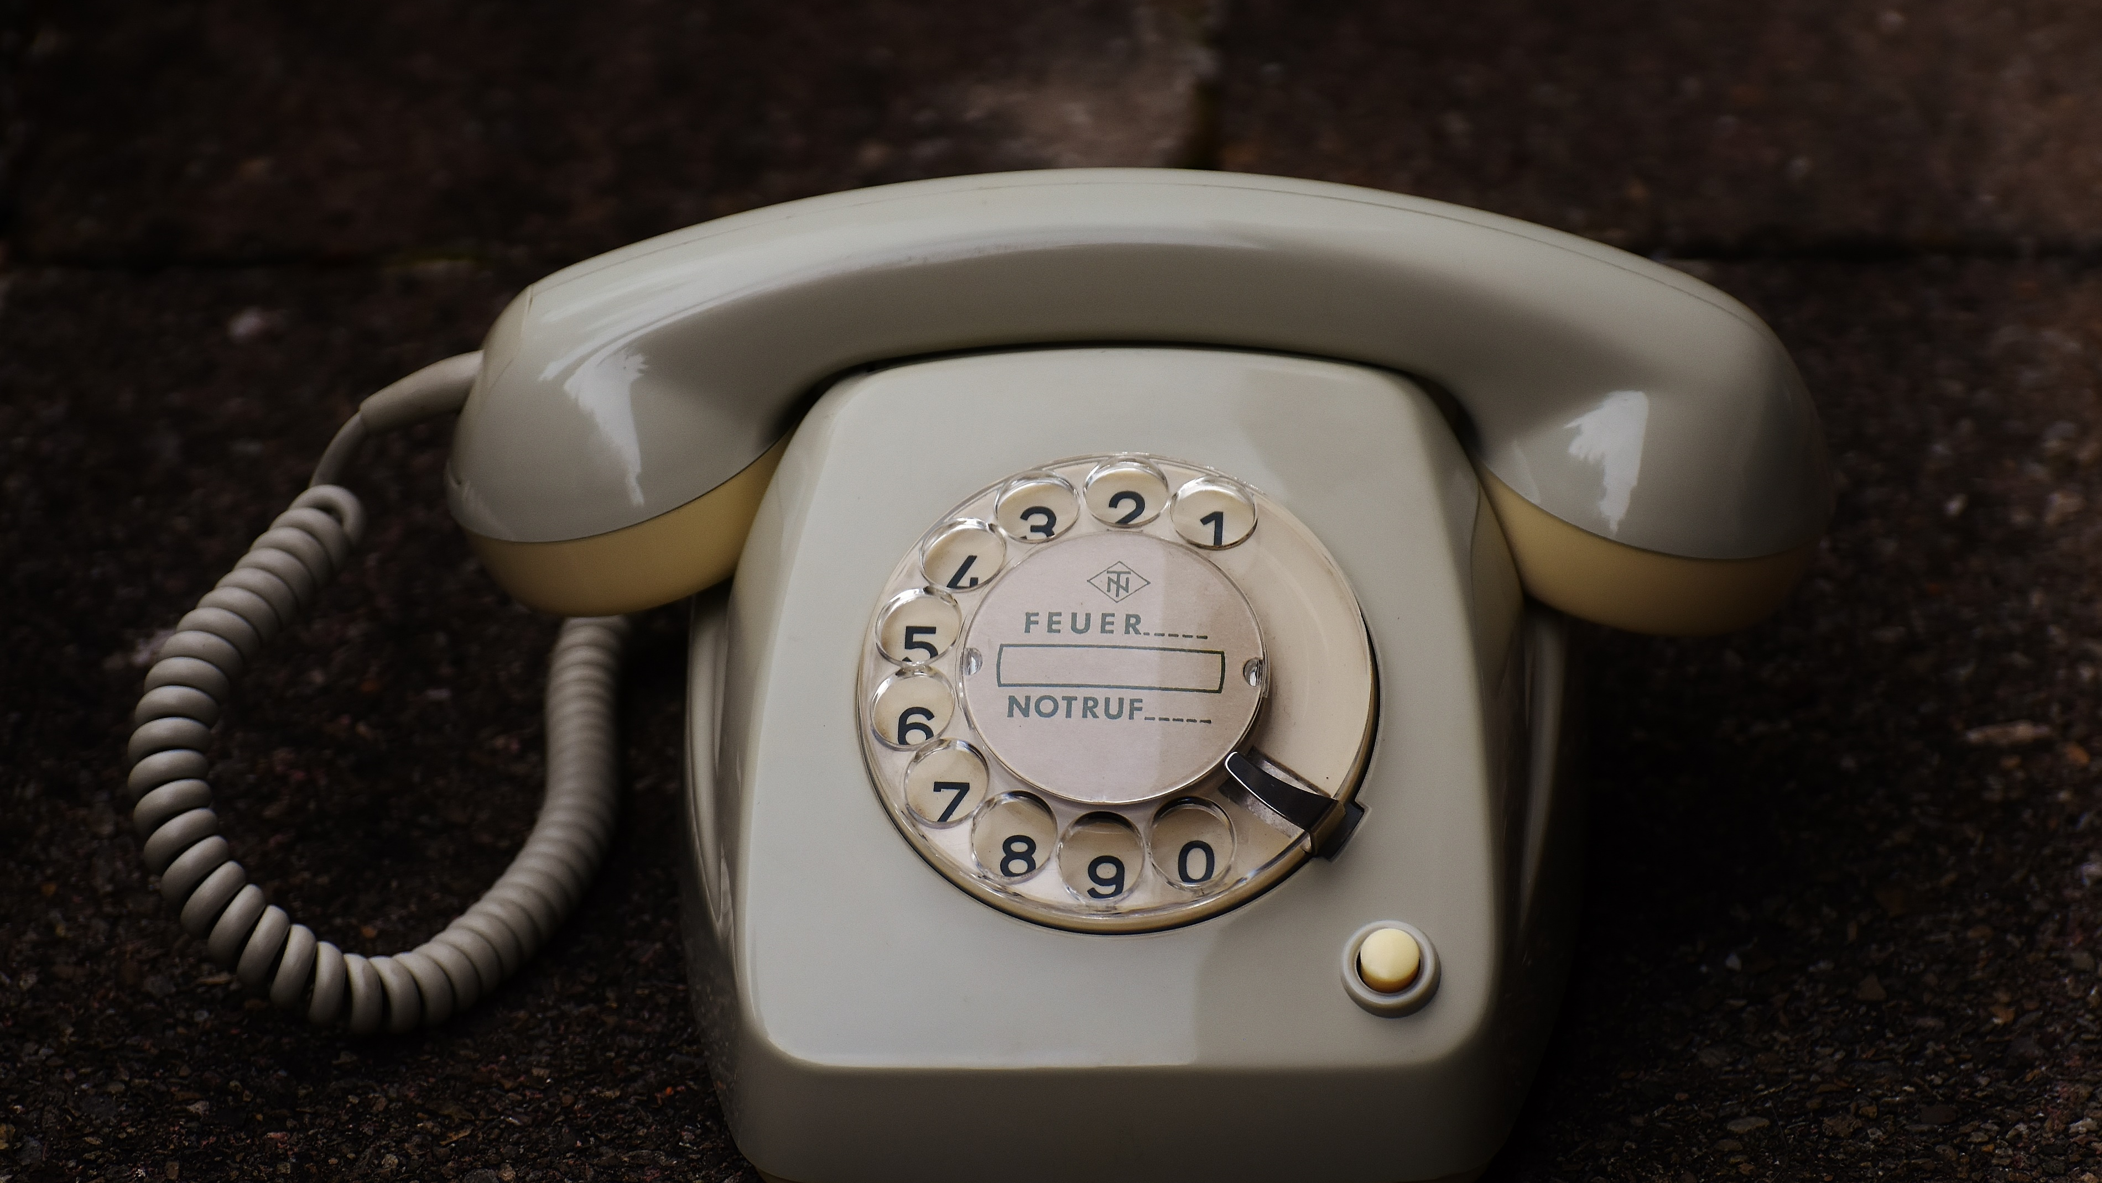
Telephone We can talk to people in any part of the world over the telephone . Landline phones , however , are no longer popular . They have been replaced by mobile phones . Smart phones are all – in – one devices with we can do many things .

Slide 9
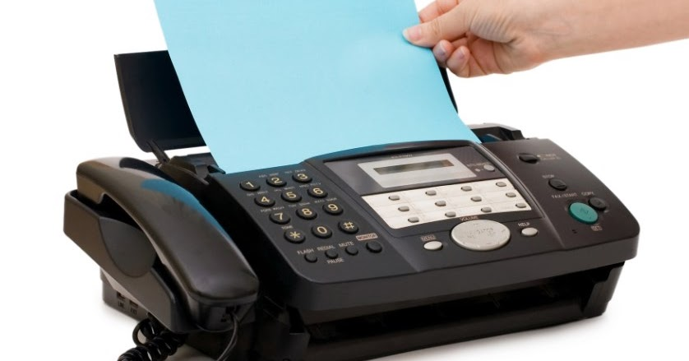
Fax A written document can be sent through a fax machine . It takes only a few seconds to reach . The fax machine is connected to a telephone line . Fax ( short for facsimile ) , sometimes called telecopying or telefax ( the latter short for telefacsimile ) .
This Photo by Unknown Author is licensed under CC BY-SA-NC

Slide 10
Internet and email We can sit at home , access any website , and get information on any topic through the Internet Email or electronic mail , sent through the Internet , has made communication faster and cheaper . Nowadays many people access Internet on their smart phones .
This Photo by Unknown Author is licensed under CC BY-NC

Slide 11
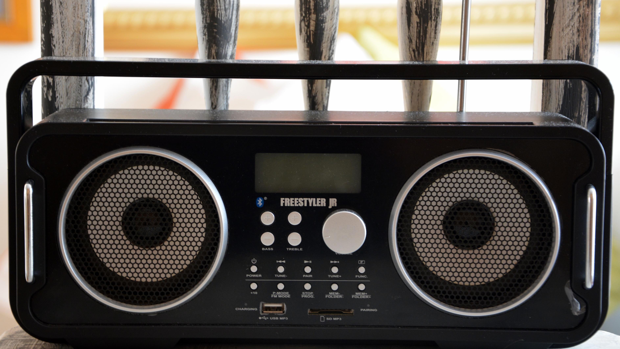
Radio A pro gramme on radio reaches all corners of India . It is useful even to those people who cannot read and write . The all India radio broadcasts news and educational pro grammes in Hindi , English and many regional languages . Private FM channels also broadcast pro grammes for the people .

Slide 12
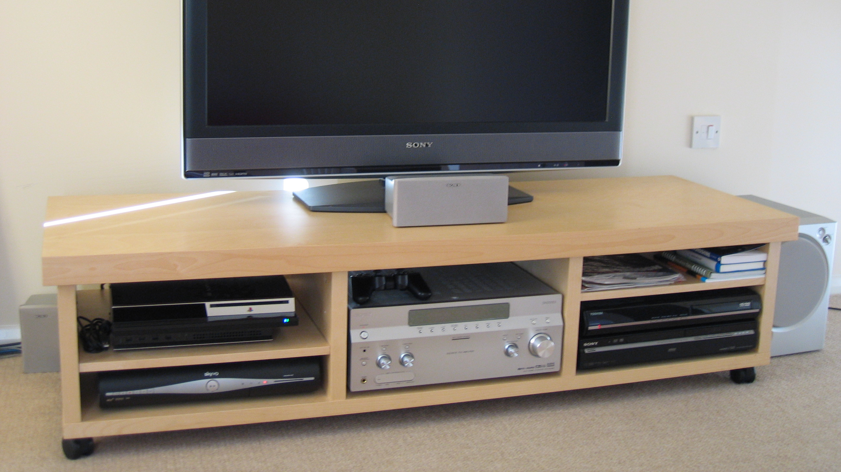
Television Tele vision per forms the same task as radio , but also shows pictures . Sitting at home you can watch what is happening in other parts of our country and elsewhere in the world . Today there are many television channels in India .
This Photo by Unknown Author is licensed under CC BY-SA

Slide 13
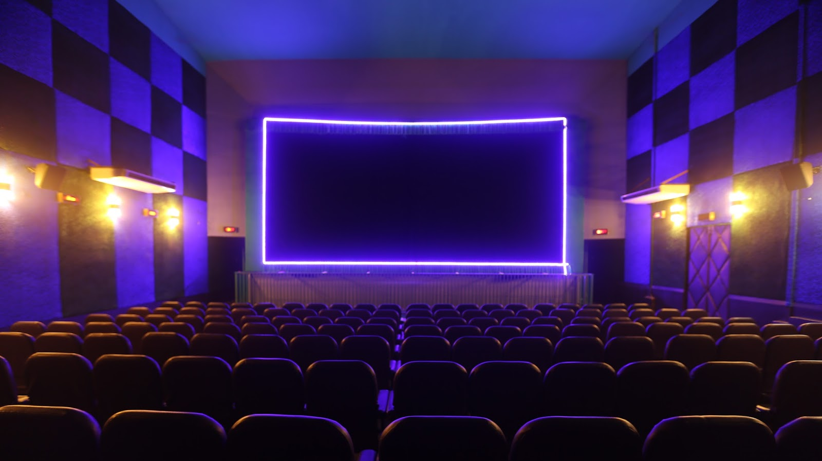
Cinema Movies are made in many languages . They educate as well as enter tiain . They also spread social messages .
This Photo by Unknown Author is licensed under CC BY-NC-ND

Slide 14
News paper A large number of news papers and magazines are published in India . These carry news and information about events from all parts of the world . Some people read e – news paper on their tables and smart phones .
This Photo by Unknown Author is licensed under CC BY-SA-NC

Slide 15
Video

